Slide 1
This is a hidden slide
Dear honorable teacher please follow the instructions that has given in the slide notes.(under the every slide). It would be helpful to take a successful class. Thanks a lot. I wish you good luck.

Slide 2
WELCOME
Notes:
Teacher can say it orally.

Slide 3
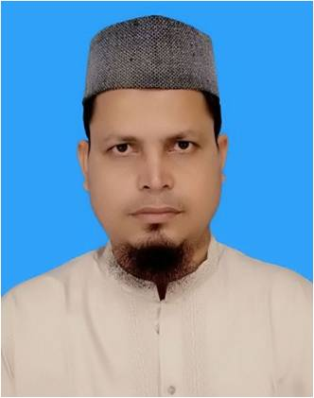
IDENTITY
SK. Md. Harunar Rashid
Senior Assist: Teacher
Sonatola Model High School,
Sonatola, Bogra.
Lesson
ENGLISH FOR TODAY
CLASS : SIX
UNI – 16
Notes:
Teacher can hide this slide

Slide 4
Let`s enjoy a video clip
T: Do you know what about the video?
S: Sir, It a Aesop`s fable “ Unity is strength”.
Notes:
Showing the video teacher can ask the question to the whole class. SS will raise their hands. Teacher can ask 5/6 students to narrate the video.

Slide 5
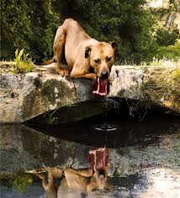
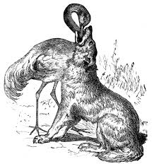
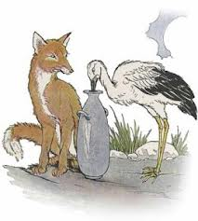
Look at the pictures and talk your partner about the pictures.
Do you know what about the pictures ?
S: Sir, These are fables by Aesop.
Notes:
Showing the picture teacher can ask the question to the whole class. SS will raise their hands. Teacher can ask 5/6 students to narrate the picture.

Slide 6
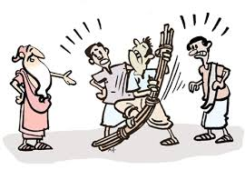
Today`s topic
Aesop`s fable.
Notes:
Teacher also say it orally.

Slide 7
Learning outcomes
After completing this lesson, students will be able to-
read and understand texts
infer meaning from context
ask and answer questions
Write answers to questions.

Slide 8
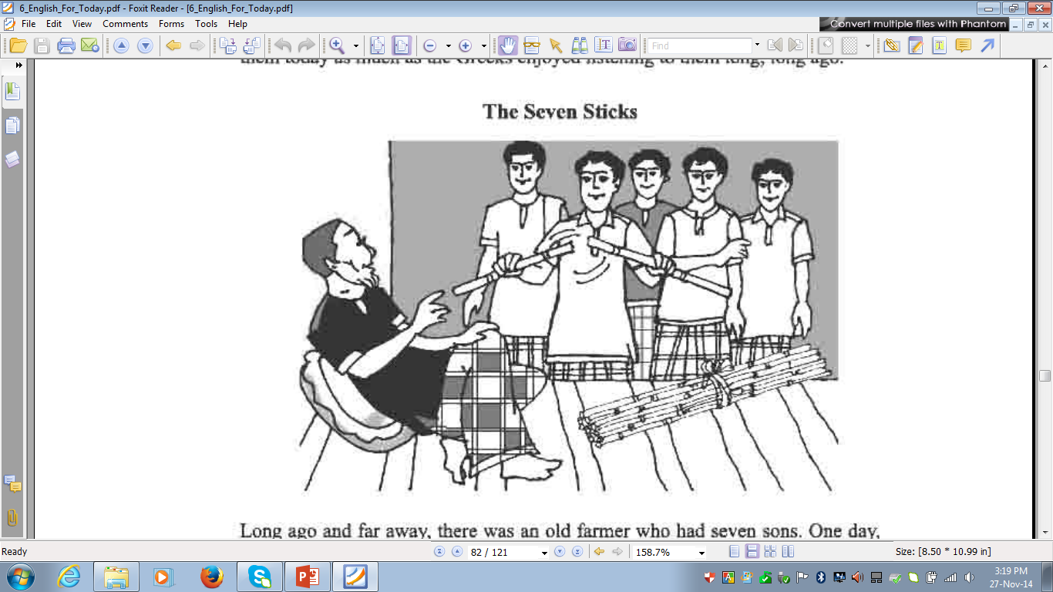
Section - A
Go to the text – Read the introduction first and
then the story below.
Notes:
Students will read silently by the instruction of T.

Slide 9
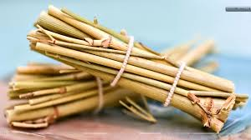
Bundle
Key word
The wise farmar`s sons could not break the bundle.
Try to say the meaning and make sentence of following word :
Meaning
(Click here)
Bale
Notes:
First, the word can be shown. The SS can be asked to pronounce the word. If it is needed teacher can help. Then the picture can be shown and asked to guess the meaning. For feedback click on meaning button.

Slide 10
Break
Key word
Try to say the word meaning and make sentence.
They could not break the bundle
Meaning
(Click here)
Interruption / halt
Notes:
First, the word can be shown. The SS can be asked to pronounce the word. If it is needed teacher can help. Then the picture can be shown and asked to guess the meaning. For feedback click on meaning button.

Slide 11
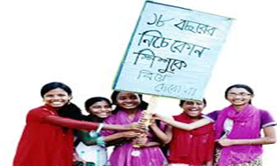
Unity
Key word
Try to say the word meaning and make sentence.
The moral of this story - ‘’Unity is strength”.
Meaning
(Click here)
Together
Notes:
First, the word can be shown. The SS can be asked to pronounce the word. If it is needed teacher can help. Then the picture can be shown and asked to guess the meaning. For feedback click on meaning button.

Slide 12
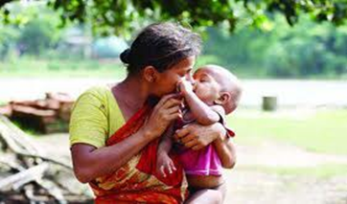
Affection
Key word
Every mother has real affection for her child.
Try to say the word meaning and then make sentence.
Meaning
(Click here)
Love / Care / Liking / Friendliness
Notes:
First, the word can be shown. The SS can be asked to pronounce the word. If it is needed teacher can help. Then the picture can be shown and asked to guess the meaning. For feedback click on meaning button.

Slide 13
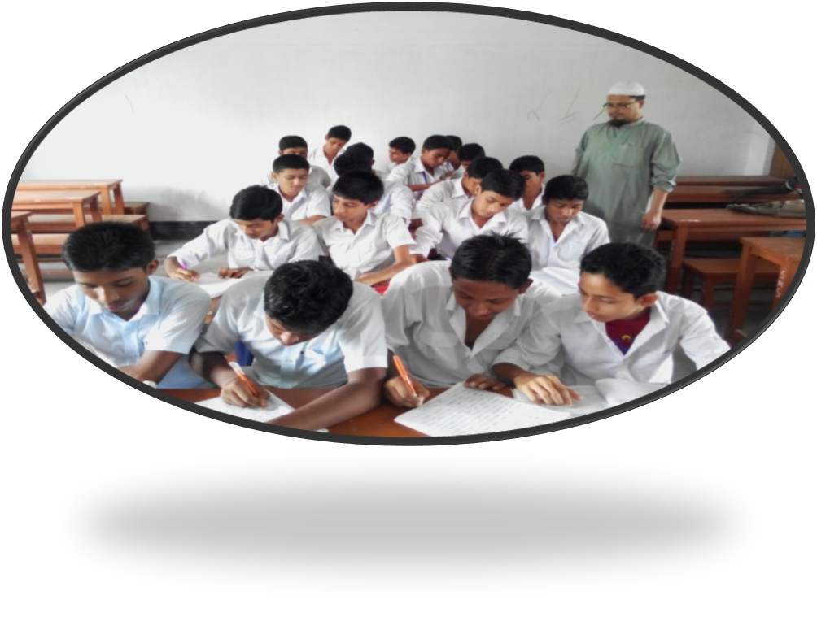
Pair Works
Go to section A1, read attentively.
What do you think is the main idea or the moral of the story? Discuss in groups.
Notes:
Teacher can evaluate it by orally or written from the SS.

Slide 14
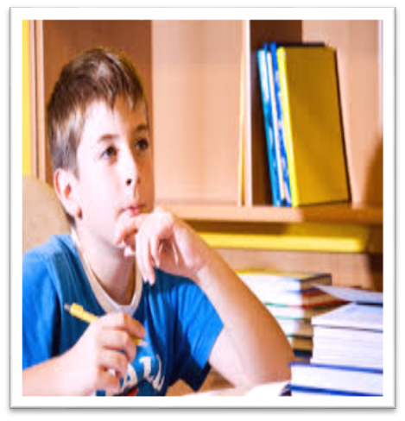
Individual Work
Read the text silently and write a few simple sentences to explain what you mean by ‘In unity is strength’.
Notes:
Teacher can evaluate it by orally or written from the SS.

Slide 15
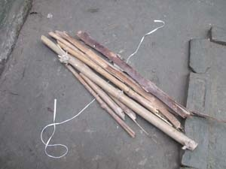
Language Focus
We use un, in, im, dis etc before a word to mean not or opposite of that word.
Such as :-
Tied
Untied
Notes:
First, the teacher can discuss some prefix, some main words and its opposite words. Then the picture can be shown and asked to guess the meaning. Then the meaning can be shown with their opposite meaning.

Slide 16
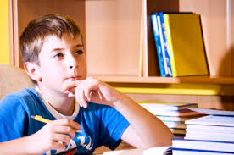
Language Focus
That words start with ‘m’ or ‘p’ there used – ‘im’ to make opposite. Such as :
I read in class six.
They reads in class six.
Correct
Incorrect
Notes:
First, the teacher can discuss some prefix, some main words and its opposite words. Then the picture can be shown and asked to guess the meaning. Then the meaning can be shown with their opposite meaning.

Slide 17
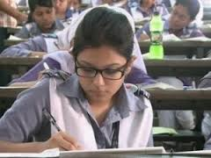
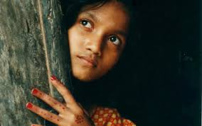
Language Focus
That words start with ‘r’ there used – ‘ir’ to make opposite meaning. Such as :
Ruma is a regular student.
Sima is a irregular student.
regular
irregular
Notes:
First, the teacher can discuss some prefix, some main words and its opposite words. Then the picture can be shown and asked to guess the meaning. Then the meaning can be shown with their opposite meaning.

Slide 18
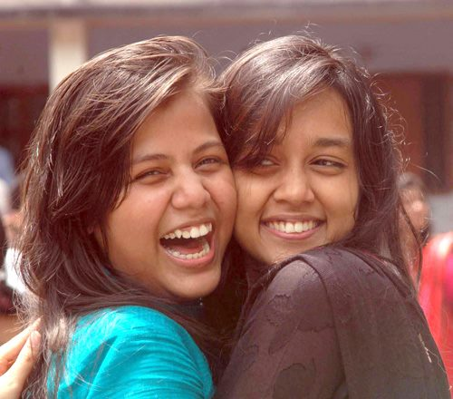
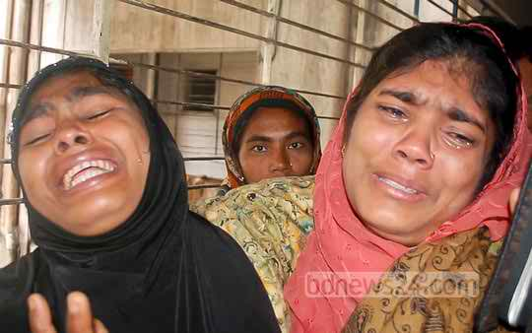
Language Focus
Before adjective/verb we use ‘un’ to make opposite
They are happy.
They are unhappy.
Happy
Unhappy
Notes:
First, the teacher can discuss some prefix, some main words and its opposite words. Then the picture can be shown and asked to guess the meaning. Then the meaning can be shown with their opposite meaning.

Slide 19
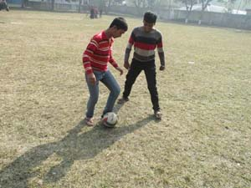
Language Focus
Before adjective/verb we use ‘dis’ to make opposite
We like to play football.
We dislike smoking.
Like
Dislike
Notes:
First, the teacher can discuss some prefix, some main words and its opposite words. Then the picture can be shown and asked to guess the meaning. Then the meaning can be shown with their opposite meaning.

Slide 20
Individual / Group Works
Now go to section – A3. Read the sentences ‘a – d’ attentively. Then fill in each blank with a suitable new word.
Notes:
Teacher can evaluate it by orally or written from the SS.

Slide 21
HOME WORK
Write down the moral of this story.
Notes:
Teacher can give some instructions to do the home work.

Slide 22
Acknowledgement
We would like to express our cordial gratitude to the Ministry of Education, Directorate of Secondary & Higher Education, NCTB, a2i
and
the panel of honorable editors ( Md. Jahangir Hasan, Associate Professor (English) TTC, Rangpur, Ranjit Poddar, Associate Professor (English) TTC, Dhaka, and Urmila Ahmed, Associate Professor (English) TTC, Dhaka, to enrich the contents.

Slide 23
THE END
Notes:
Teacher can say thanks to you.

